Slide 1


Department of Electronics and Telecommunication (E&TC) Engineering Academic Year 2021-22
A PROJECT PRESENTATION ON
Canopy Detection and Pesticides Spraying Using Agricultural Drones
BY
1. SUDHIR BHAUSAHEB PAWAR
2. YASH NILESH SHINDE
3. HRISHIKESH VINOD MORE
GUIDED BY
Dr. Mrs. G. M. PHADE

Slide 2
INDEX
Introduction
Problem statement
Literature survey
Objective
Block diagram
Flowchart
Methodology
Hardware/Software
Advantages
Conclusion
Future scope
References

Slide 3
INTRODUCTION
This idea is to make a drone carrying a payload containing pesticides with the ability to detect sapling and spraying only the required amount.
In past, there have been incidents in the news recently where farmers got injured and had to be hospitalized due to the hand spraying of chemical fertilizers. Hand spraying method for fertilizer is also inefficient as it causes overuse and thus decreasing soil’s nutrients.

Slide 4
PROBLEM STATEMENT
There are too many technologies involved in today’s Agriculture, out of which spraying pesticides using drones is one of the emerging technologies. Manual pesticide spraying causes many harmful side effects to the personnel involved in the spraying process. The Exposure effects can range from mild skin irritation to birth defects, tumors, genetic changes, blood and nerve disorders, endocrine disruption, coma or death. The WHO (World Health Organization) estimated as one million cases of ill affected, when spraying the pesticides in the crop field manually. This paved the way to design a drone mounted with spraying mechanism to atomize in fine spray ,a hexacopter configuration

Slide 5
frame, suitable landing frame, 6 Brushless Direct Current (BLDC) motors with suitable propellers to produce required thrust and suitable LithiumPolymer (LI-PO) battery of current capacity to meet necessary current and voltage requirements. A First-Person View (FPV) camera and transmitter can also be fixed in the drone for monitoring the spraying process and also for checking pest attacks on plants. This pesticide spraying drone reduces the time, number of labor and cost of pesticide application. This type of drone can also be used to spray disinfectant liquids over buildings, water bodies and in highly populated areas by changing the flow discharge of the pump.

Slide 6
LITERATURE SURVEY
Dongyan et al. (2015) [1] experimented on effective swath width and uniformity of droplet distribution over aerial spraying systems like M-18B and Thrush 510G.These agricultural planes flew at height of 5 m and 4 m respectively and with this experiment they reach to conclusion that flight height leads to the difference in swath width for M-18B & Thrush 510G. Huang et al. (2015) [2] made a low volume sprayer which is integrated into unmanned helicopters. The helicopter has a main rotor diameter of 3 m and a maximum payload of 22.7 kg. It used to require at least one gallon of gas for every 45 minutes. Rahul Desale et al. (2019) [3] described an architecture based on UAV that could be employed for agricultural applications. Their UAV was designed not only for spraying but also for monitoring agricultural fields with the use of cameras and GPS. Their design was optimized for cost and weight. Kurkute et al. (2018) [4] worked on quadcopter UAV and its spraying mechanism using simple cost-effective equipment. The universal sprayer system is used to spray for both liquid and solid content.

Slide 7
OUTCOME OF LITERATURE SURVEY
Payload capacity of drones.
Automatic Crop Detection/Monitoring.

Slide 8
OBJECTIVE
Drone with ability to detect a green field autonomously.
Reducing the cost required for the drone compared to present solutions.

Slide 9
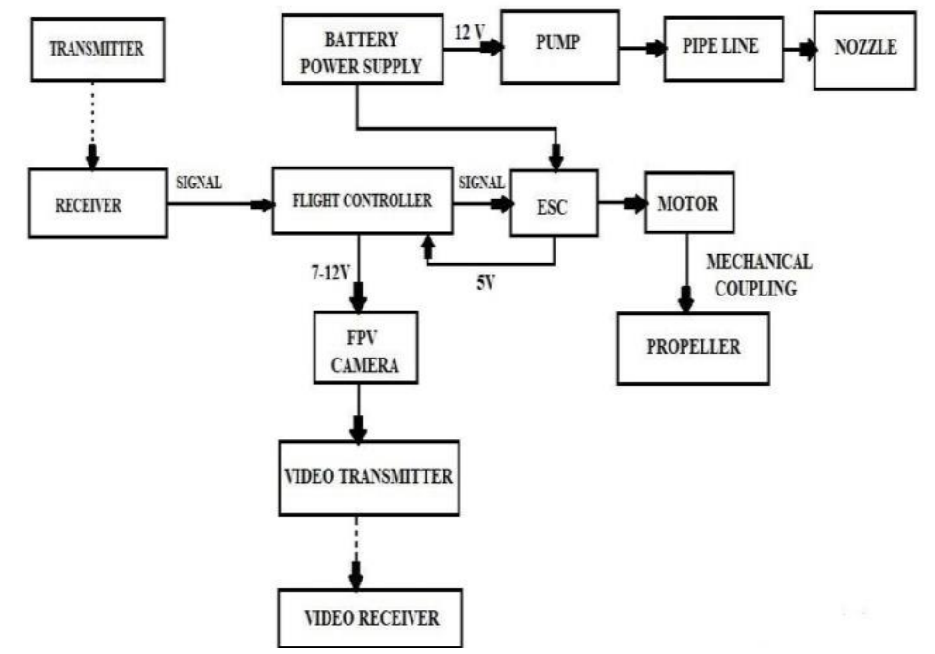
Block Diagram

Slide 10
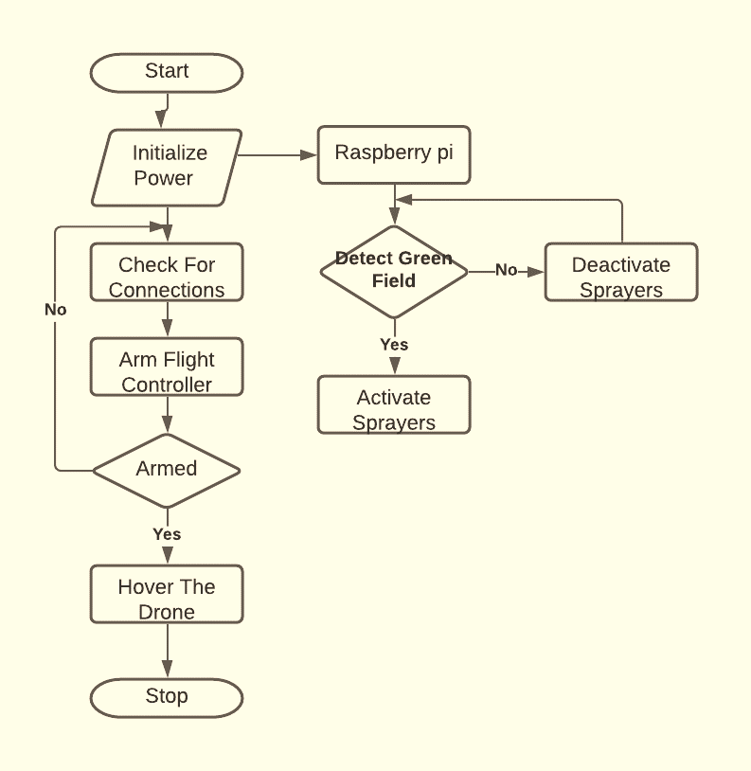
FLOWCHART

Slide 11
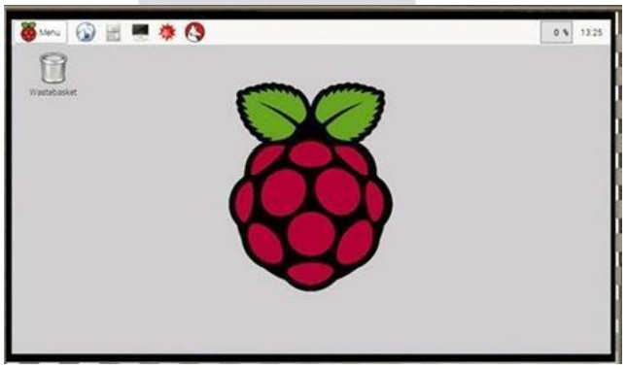
METHODOLOGY
RASPBERRY PI :-
It look like a credit card but it perform as a mini computer .it used for many things that desktop PC does like video word processing,
spread sheets, home automation server,
parent detectors to weather stations,
tweeting houses of birds with IR cameras etc.
After installing the Raspbian OS we can get the Raspberry pi desktop as shown in the fig
which is similar to our normal computer desktop.

Slide 12
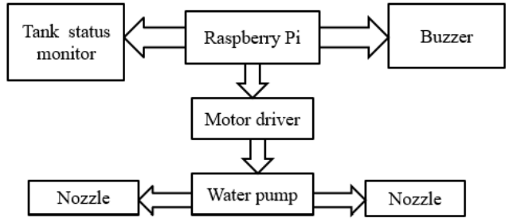
METHODOLOGY
Spraying Mechanism :-
There are a lot of plant protection products exist today. Main pesticides that used in precision agriculture are:
1) Insecticides
2) Fungicides
3) Herbicides
Crops spraying Drones suited ideally for
such task, because most fields needs ultra-
low application volumes of pesticides per hectare, only on some specific zones of a field and only at some specific time.

Slide 13
Hardware/Software
Software :
Raspberry Pi OS
Mission Planner
Python OpenCV
Hardware :
Drone
Raspberry Pi
Pump
Water Sprinkler
Motor Driver IC
Water Float Sensor

Slide 14
ADVANTAGES
High Productivity
Low Fuel Consumption
Low Noise Pollution
No chemical contamination risks for operator
Crop dusting costs are much lower
Ultra-low volumes spraying methods, avoids waste of water and ground waters contamination
Multifunctional Frame

Slide 15
CONCLUSION
This method of spraying pesticides on Agricultural fields reduces the number of labors, time, cost and the risk involved to the personnel involved in spraying the liquids. This drone can also be used in spraying disinfectant liquids over buildings, water bodies and highly populated areas.
Drone is responsible for both spraying chemicals and monitoring of agricultural fields, environment.
It helps in improves coverage, boosts chemical effectiveness and makes spraying job easier and faster.

Slide 16
FUTURE SCOPE
The maximum quantity of fertilizer that the drone carries can be increased.
Battery life can be increased.
With image processing techniques, the drone can be involved in surveillance to determine the pest attack on the plants, condition of ripening fruit.

Slide 17
REFERENCES
C. Zhang, J. M. Kovacs, ”The application of small unmanned aerial systems for precision agriculture: a review”, Precision Agriculture, Springer, 2012.
MIT Technology Review, ”Agricultural Drones. Relatively cheap drones with advanced sensors and imaging capabilities are giving farmers new ways to increase yields and reduce crop damage”, http://www.technologyreview.com/featuredstory/526491/agricultural-drones/, 2015.
I. Colomina, P. Molina, ”Unmanned aerial systems for photogrammetry and remote sensing: a review”, ISPRS Journal of Photogrammetry and Remote Sensing, June 2014.
L. Hassan-Esfahani, A. Torres-Rua, A. M. Ticlavilca, A. Jensen, M. McKee, “Topsoil Moisture Estimation for Precision Ag riculture Using Unmanned Aerial Vehicle Multispectral Imagery”, 2014 IEEE International Geoscience and Remote Sensing Symposium, 2014.

Slide 18
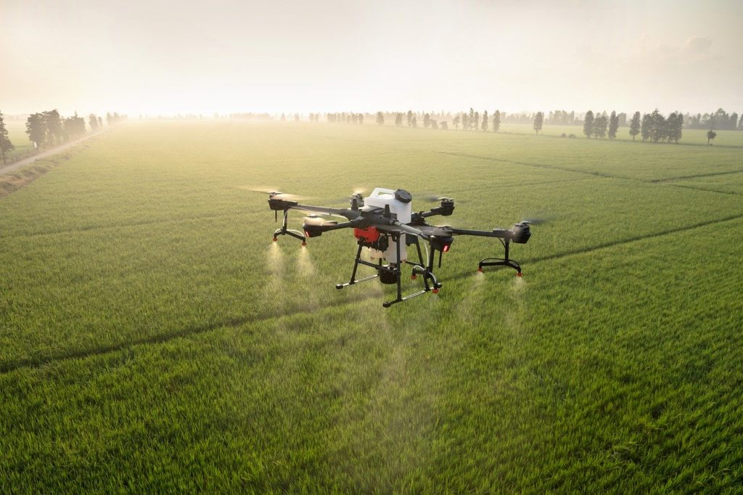
Thank
You..

